Slide 1
An optimized search algorithm for gravitational waves from post-merger remnants
Student: Christopher Nadeau, University of Rhode Island
cmnadeau@uri.edu
Mentor: Dr. Gaurav Khanna, URI
gkhanna@uri.edu
Researcher: Dr. Rob Coyne, URI
robcoyne@uri.edu
02/10/21

Slide 2
An optimized search algorithm for gravitational waves from post-merger remnants
The CoCoA algorithm was developed for use to bridge the gap in detection between highly constrained, sensitive searches and generalized searches more usable in real-time.
CoCoA a factor of ~4 improvement in between these two regimes
Current implementation is in the now-outdated Python 2.7. This project calls to update the codebase and ensure it is capable of executing on modern HPC resources
Additionally, some of the most computationally intensive aspects of CoCoA could be adapted to efficiently utilize the graphics-processing unit (GPU) compute elements of modern HPC implementations
Notes:
at its extremes, it matches the performance of other search algorithms, while achieving a factor of ~4 improvement over the least sensitive version of comparable GRB remnant searches in the area between these two regimes

Slide 3
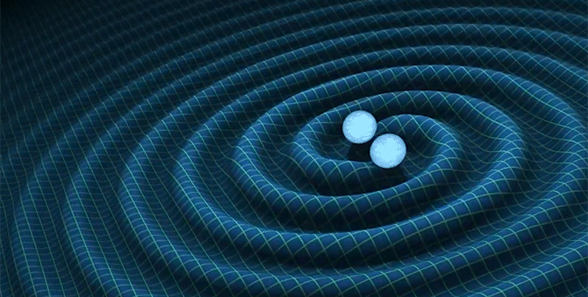
An optimized search algorithm for gravitational waves from post-merger remnants
Background:
Gravitational Waves: Ripples in space-time caused by acceleration of masses
Detectable waves generally generated by inspiral of black hole/black hole, neutron star/neutron star, or black hole/neutron star pairs.
Image: R. Hurt, Caltech / JPL
Notes:
Under detectable waves: because gravity is a relatively weak force, it takes extremely large masses to generate detectable levels of GWs hence why BH/NS are the objects of interest
BH: Region of spacetime where gravity is so strong that light cannot escape
Neutron Star: Result of the supernova of a supermassive star combined with a gravitational collapse that compresses the core. These objects are some of the most dense objects known to exist.

Slide 4
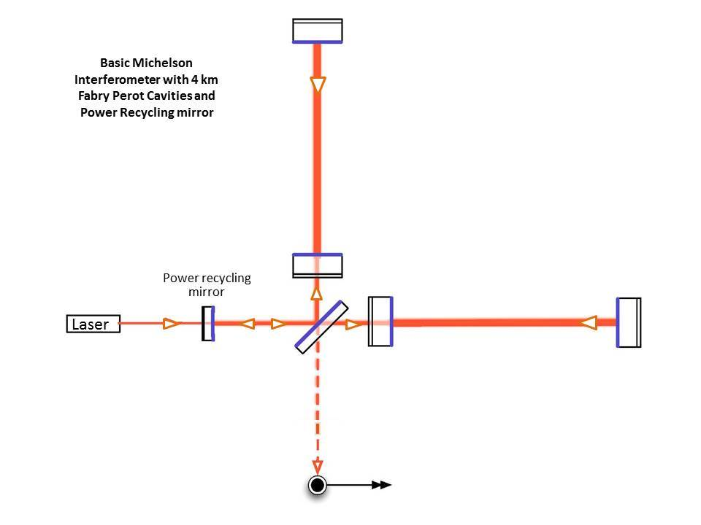
An optimized search algorithm for gravitational waves from post-merger remnants
Detection:
Laser Interferometer Gravitational Wave Observatory (LIGO, USA) in collaboration with Virgo (EU) and recently KAGRA (JP)
These observatories use hybrid interferometry with beam lengths of several kilometers to detect movement on the scale of ~10⁻¹⁸m
Image: https://www.ligo.caltech.edu/page/ligos-ifo
Notes:
First detection was ~5 yrs ago
Won Breakthrough Prize in Fundamental Physics (2016) and the Nobel Prize (2017) most notably
Reiterate the purpose of cocoa
detection scale+ ~1/10,000th the width of a proton

Slide 5
An optimized search algorithm for gravitational waves from post-merger remnants
Goals/Timeline:
* Due to allowing time for a background study
Update to Python 3
Ensure compatibility with existing HPC resources
Milestone 2
Start: Mar 1*
Milestone 3
Investigate GPU utilization
End: Apr 1
Start: Apr 1
Milestone 4
Remainder
End: May 1

Slide 6
An optimized search algorithm for gravitational waves from post-merger remnants
Learning Goals:
Signal Analysis Methods
Improve Python knowledge / library conflict resolution
Use of HPC resources
Profiling code
GPU acceleration techniques
Notes:
hpc resources: currently does run, specifically condor (only used by a few scientific groups) will be transitioning to slurm

Slide 7
An optimized search algorithm for gravitational waves from post-merger remnants
Done so far:
Gain access to HPC resources
Access COCOA GitLab / LIGO credentials
Begun to explore the COCOA codebase/verify current installation instructions
Notes:
because working with ligo its pretty confidential; will be working with largely open data (unrestricted) certain updates will have to be vague

Slide 8
An optimized search algorithm for gravitational waves from post-merger remnants
Next Month:
Become acquainted with HPC resources
  RPI CCI Cluster
  URI HPC Resources
Review code & develop conversion plan

Slide 9
An optimized search algorithm for gravitational waves from post-merger remnants
Help Needed:

