Slide 1
UVM Art + AI Research Group Phase 2 (2021)
Team Members:
Cameron Bremner, cbremner@uvm.edu
Syd Culbert, sydney.culbert@uvm.edu
Halina Vercessi-Clarke, halina.vercessi-clarke@uvm.edu
Clem Fisher, clement.fisher@uvm.edu
Mentor:
Kerime Toksu, University of Vermont, ktuksu@uvm.edu
Researcher:
Jenn Karson, University of Vermont, jkarson@uvm.edu
9/16/2021

Slide 2
UVM Art + AI Research Group Phase 2 (2021)
The UVM Art + Artificial Intelligence Initiative is currently exploring the utility of Generative Adversarial Networks (GANs) in producing aesthetically pleasing and unique works of art. Using our genetic algorithm, we have curated a dataset (Athena), which we have been using as the training set in Nvidia’s StyleGAN2-ADA. The team has been experimenting with the use of transfer learning from various pre-trained networks as well as the manipulation of different variables in StyleGAN in order to generate images, which we then study to determine how to refine our process.

Slide 3
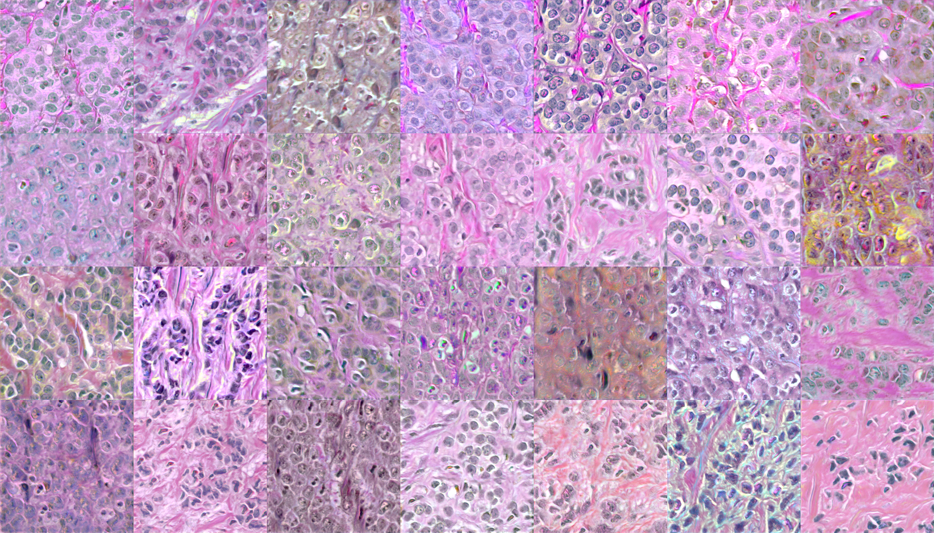
BreCaHAD breast cancer tissue images dataset

Slide 4
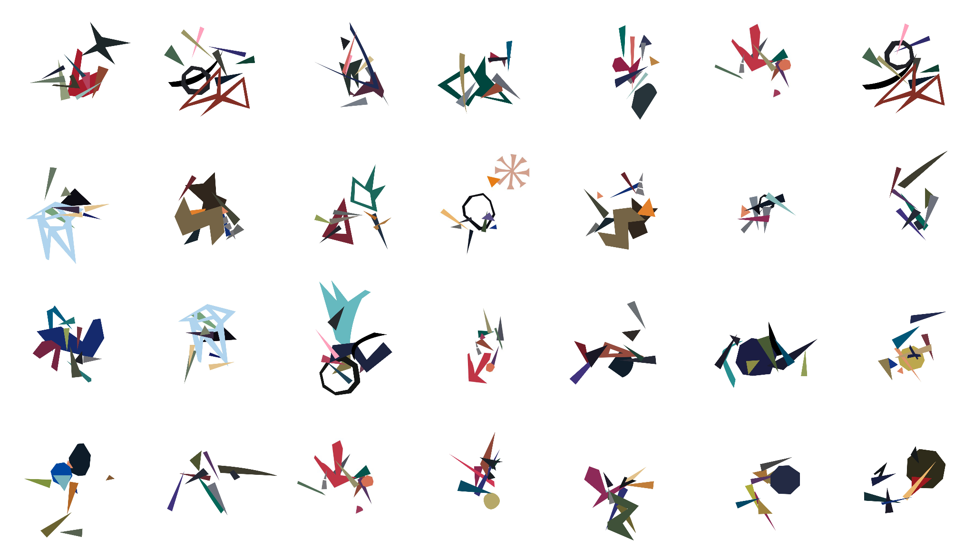
Athena dataset

Slide 5
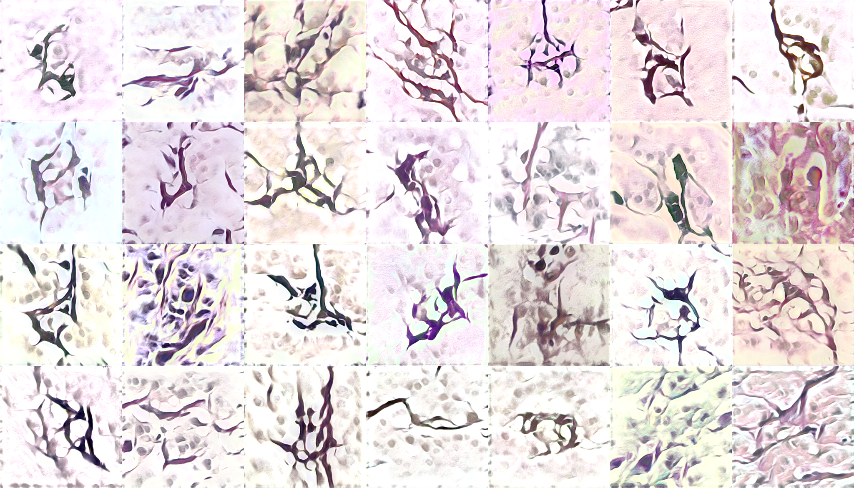
Snap 000004

Slide 6
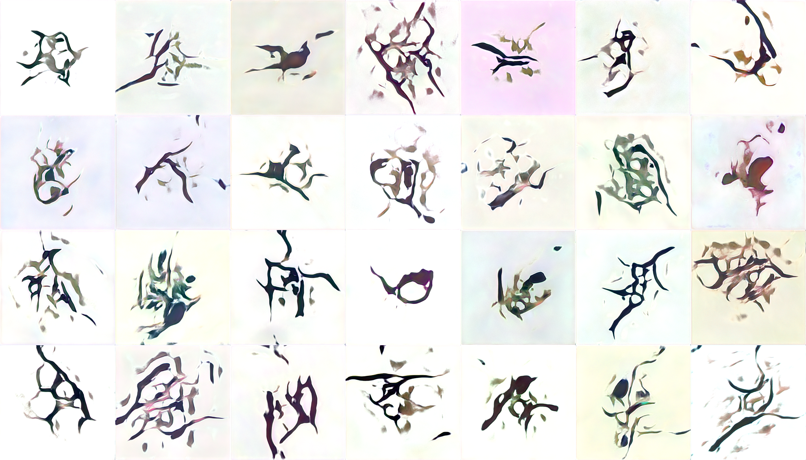
Snap 000008

Slide 7
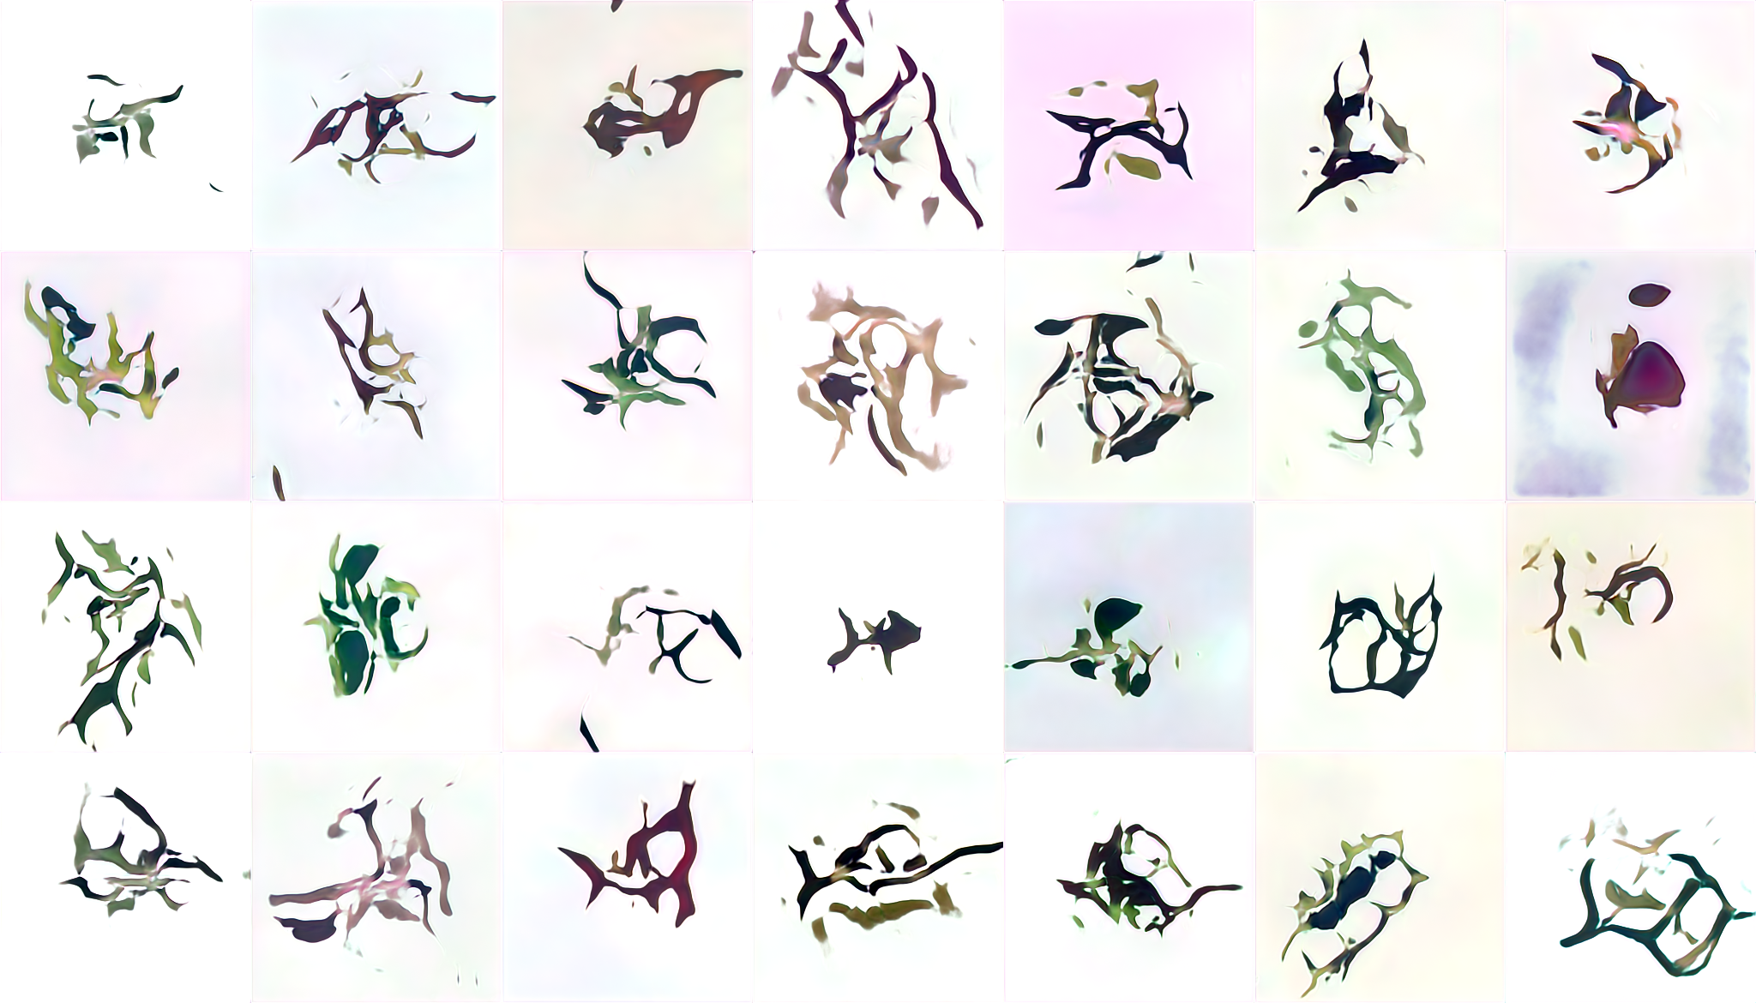
Snap 000012

Slide 8
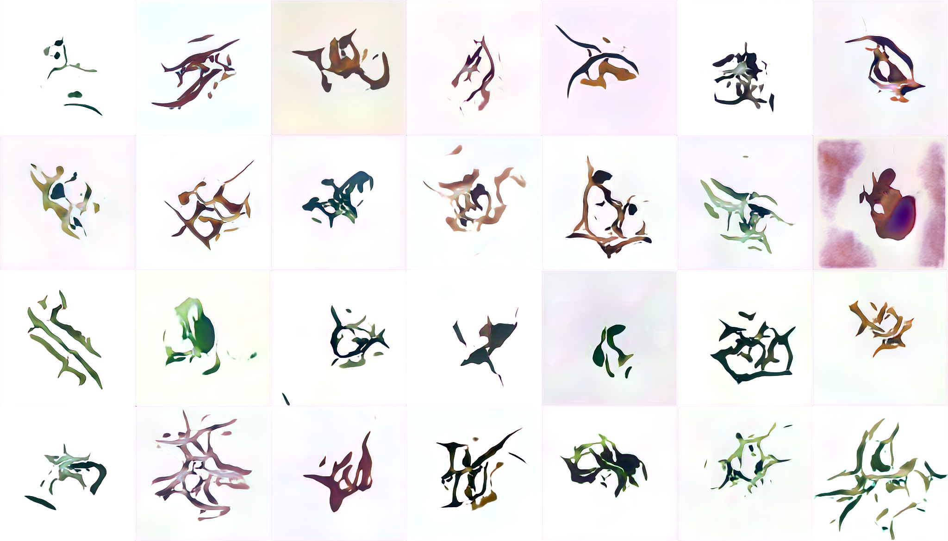
Snap 000016

Slide 9
UVM Art + AI Research Group Phase 2 (2021)
Goals
  Test both StyleGAN2-ADA and StyleGAN2 to determine which is superior, as well as optimize parameters such as training time and number of GPUs.
  Determine more specifically how transfer learning sets impact the aesthetics of generated fakes
  Improve our genetic algorithm for automating the production of the Athena dataset
  Determine points in the StyleGAN workflow that leave room for humans to more directly assert creative control
  Identify defaults within StyleGAN that do not easily allow for human artistic authorship, customization, or other user-subjectivity. Describe the taxonomies of the hardware and software that enforce such boundaries for creative exploration
  Through the practice of generating latent space walks with StyleGAN and 3dGAN, describe the cartography of latent space in non-mathematical terms that can be understood by artists who do not work with AI. Produce material examples that demonstrate this cartography.

Slide 10
UVM Art + AI Research Group Phase 2 (2021)
Timeframe
  Start date: May 31
  End date: December 22

Slide 11
UVM Art + AI Research Group Phase 2 (2021)
What we hope to learn
  How to more precisely influence the results produced through the manipulation of parameters, training sets, and transfer learning
  How to navigate latent space effectively to converge on the most aesthetic images
  How can we make GANs a more accessible tool for artists

Slide 12
UVM Art + AI Research Group Phase 2 (2021)
Goals for Next Month
  September 22nd installation
    Learn from the feedback of others
    Do people see similarities or differences between images generated using the same transfer learning set
  Begin to answer research questions and move towards more intentional results

Slide 13
UVM Art + AI Research Group Phase 2 (2021)
Plan of action/team member roles
  Syd, Cam: Further StyleGAN experimentation and dissection of the training and image generation processes with the aim of exercising more creative control over them.
  Halina: Genetic algorithm improvement / working on the generation of the Athena dataset.
  Clem: Latent spacewalk and 3d GAN research, preliminary steps to create better representations of latent space.

Slide 14
Questions?

