Slide 1

The North Woods Project
Joseph Ahart, University of Rhode Island
joseph.ahart@uri.edu
Madison Jones, DWELL Lab
madisonjones@uri.edu
Travess Smalley, DWELL Lab
travess.smalley@uri.edu
June 14th, 2023

Slide 2
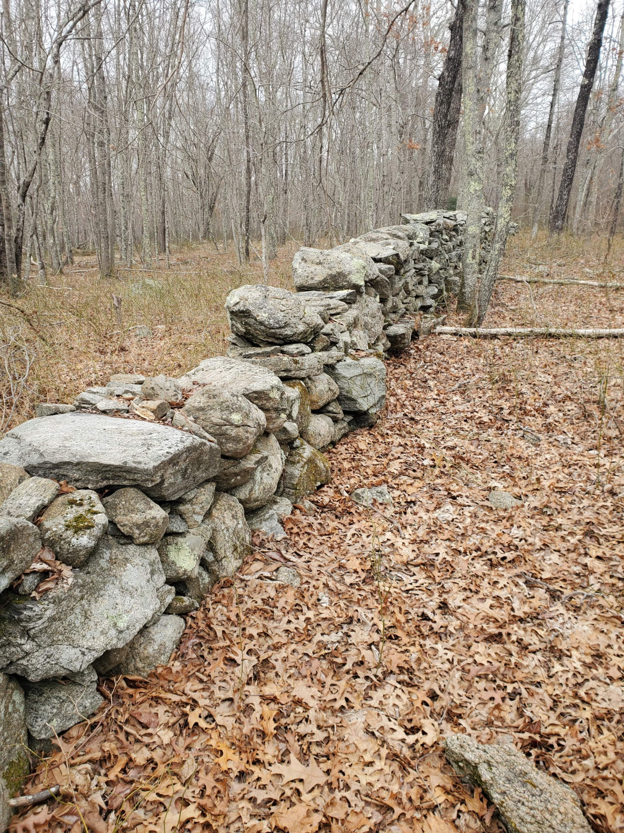
The North Woods Project
~300-acre parcel of forests and wetlands part of the University of Rhode Island’s campus.
Deep mapping
Creating a natural classroom
  Ecology
  History
  Art
  Social sciences
Using augmented reality (AR) technology to create new immersive experiences
Stone wall found within the boundaries of the North Woods/Photo: Gabrielle Pezich
Notes:
The North Woods Project is a multifaceted mission to create a strong community surrounding URI’s expansive natural area. Through various technologies, we are creating augmented experiences in order to discover new ways to engage with nature. One of our primary focuses is to create a ‘deep map’, which explores further than just geography. Ecology, history, and art can be included within a deep map layout, ultimately leading to a rich experience for everyone.
-Clarify acronyms
-Add summary

Slide 3
The North Woods Project
Goals
  Create digital content (photo/video, audio) for the North Woods Project (NWP)
  Learn and implement AR tools in the field
  Support student submissions
  Develop an understanding of deep mapping
  Strengthen current community and provide a foundation for growth
Notes:
Working with Madison Jones, Travess Smalley and other talented professionals, I am excited to be developing content for the North Woods project through a variety of mediums. Augmented reality, or AR, is one of the primary focuses on our project. We will be generating content such as trail signs, infographics, and interactive experiences that can be accessed through smart phones and other devices. This allows for endless expansion without disrupting the natural space. Students and faculty have been working on their own projects, and it is our job to ensure that these visions are able to come to life. From artists to conservationists, anyone who has a relationship with the North Woods is encouraged to share their ideas.

Slide 4
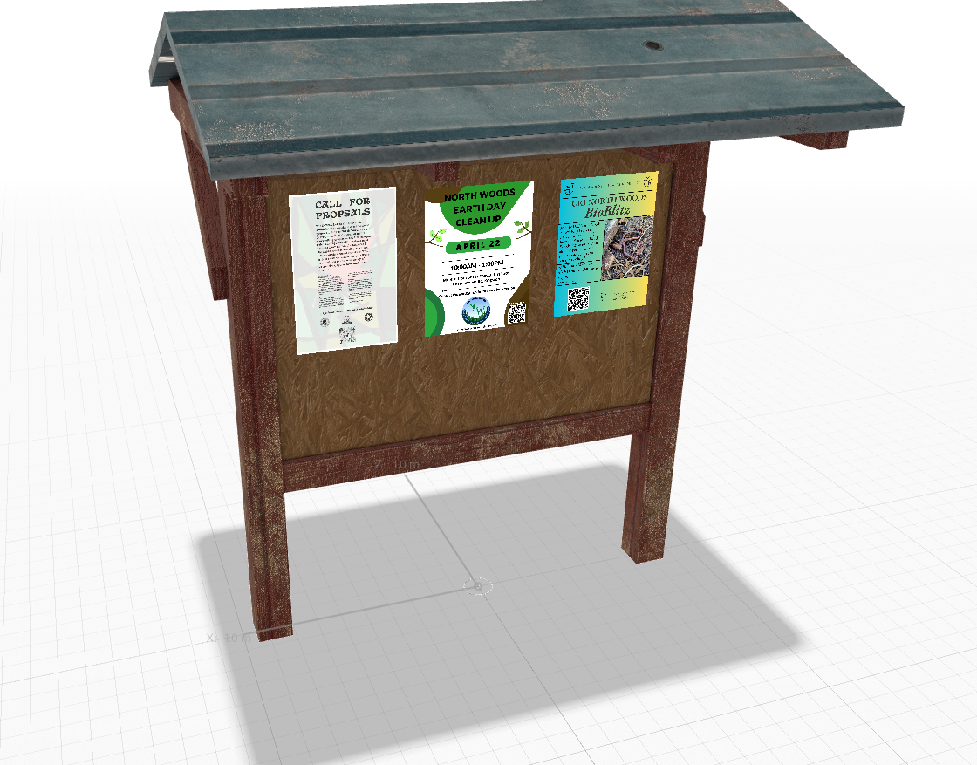
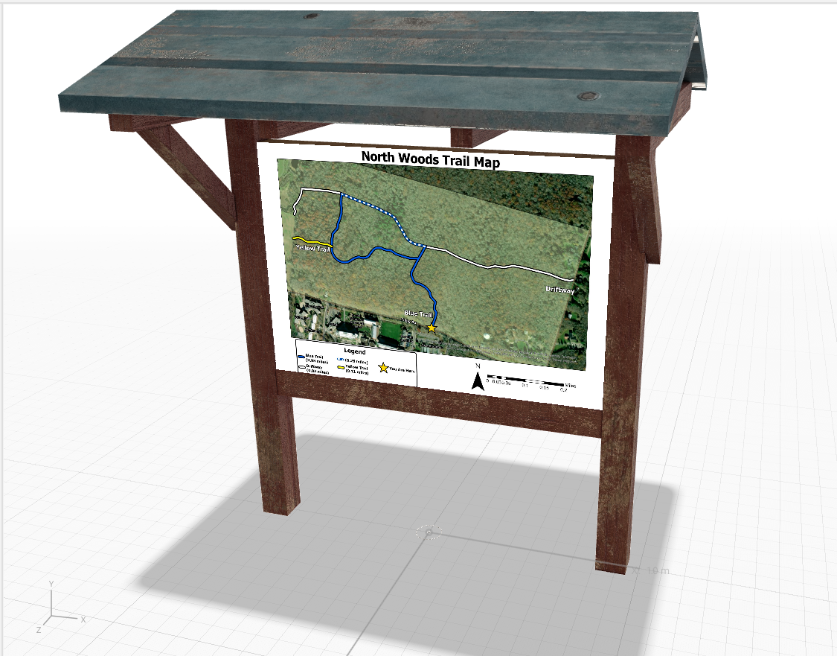
The North Woods Project
Timeframe: May 22nd, 2023 - August 4th, 2023
Front and back views of our 3D digital trailhead sign/Model: Madison Jones
Notes:
Starting at the beginning of the summer, my time with the North Woods project will span until the end of the season. While this might be the end of the program, the North Woods project will certainly continue to grow.

Slide 5

3D scan of a stone wall/Scan: Madison Jones

Slide 6
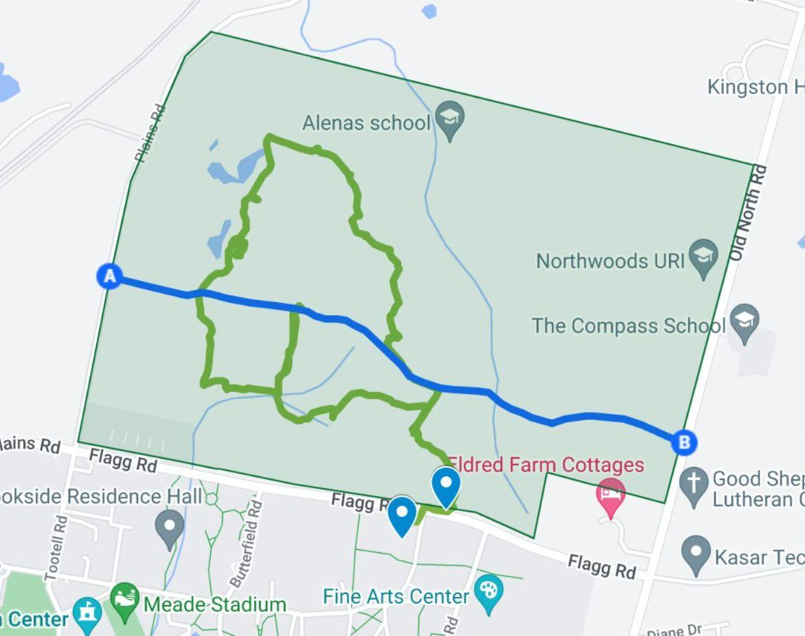
The North Woods Project
What I hope to learn
  Environmental storytelling through digital media
  AR software and web design
  Rhetorical concepts relating to space and place
  Communication skills
Notes:
While I have experience in media and storytelling, I am excited to have the opportunity to learn about all the new ways to create content. Applications like Hoverlay, Unity engine, and others will teach me the basics of AR experiences and how to create them. Other programs like GIS will also be incredibly helpful for deep mapping and organizing our project. Beyond the technical side of things, I am also exploring new ways to engage with space and place through a rhetorical lens. Creating a memorable experience requires a deep understanding of how people engage with their surroundings. As a student studying environmental communications, the North Woods project is the perfect opportunity for me to learn how to see nature through a new lens, and to share these stories through a digital framework.

Slide 7
The North Woods Project
Goals for Next Month
Begin collecting data for the North Woods deep map
Gather digital media (photos, videos, scans) to be used
Learn AR softwares (Hoverlay, Adobe Aero, etc.)
Establish a work schedule and timeline with peers
Notes:
As we begin our summer session, our primary goals are first to organize the data we currently have. Because the woods have been utilized by various departments, there is already a great amount of data we can use and implement. From there, we hope to finish drafting some of our first experience. Once this is outlined, I will be collecting content such as photos, videos and digital scans of things relating to our overall project. To make sure that I can continue working on these applications, I hope to have a solid foundation with different softwares such as Hoverlay, Adobe Aero, and Unity engine. By the end of the month, my team and I will have a solid strategy implemented for scheduling, role designations and any other important information.

Slide 8
The North Woods Project
Help needed (if any)
  Ecological knowledge
  Historical background
  Web design/UX
Notes:
Being a collaborative project in nature, I of course cannot do this project alone. Different members of the North Woods project have different areas of expertise. I hope to learn from my colleagues more about the ecological knowledge present in the North Woods, including plant and animal ID, geographic data, and other important factors. The North Woods also has a rich history spanning centuries, and I hope to learn a much as I can from experts in the field.

Slide 9
Thank you!

