Slide 1

The North Woods Project
Joseph Ahart, University of Rhode Island
joseph.ahart@uri.edu
Madison Jones, DWELL Lab
madisonjones@uri.edu
Travess Smalley, DWELL Lab
travess.smalley@uri.edu
September 13th, 2023

Slide 2
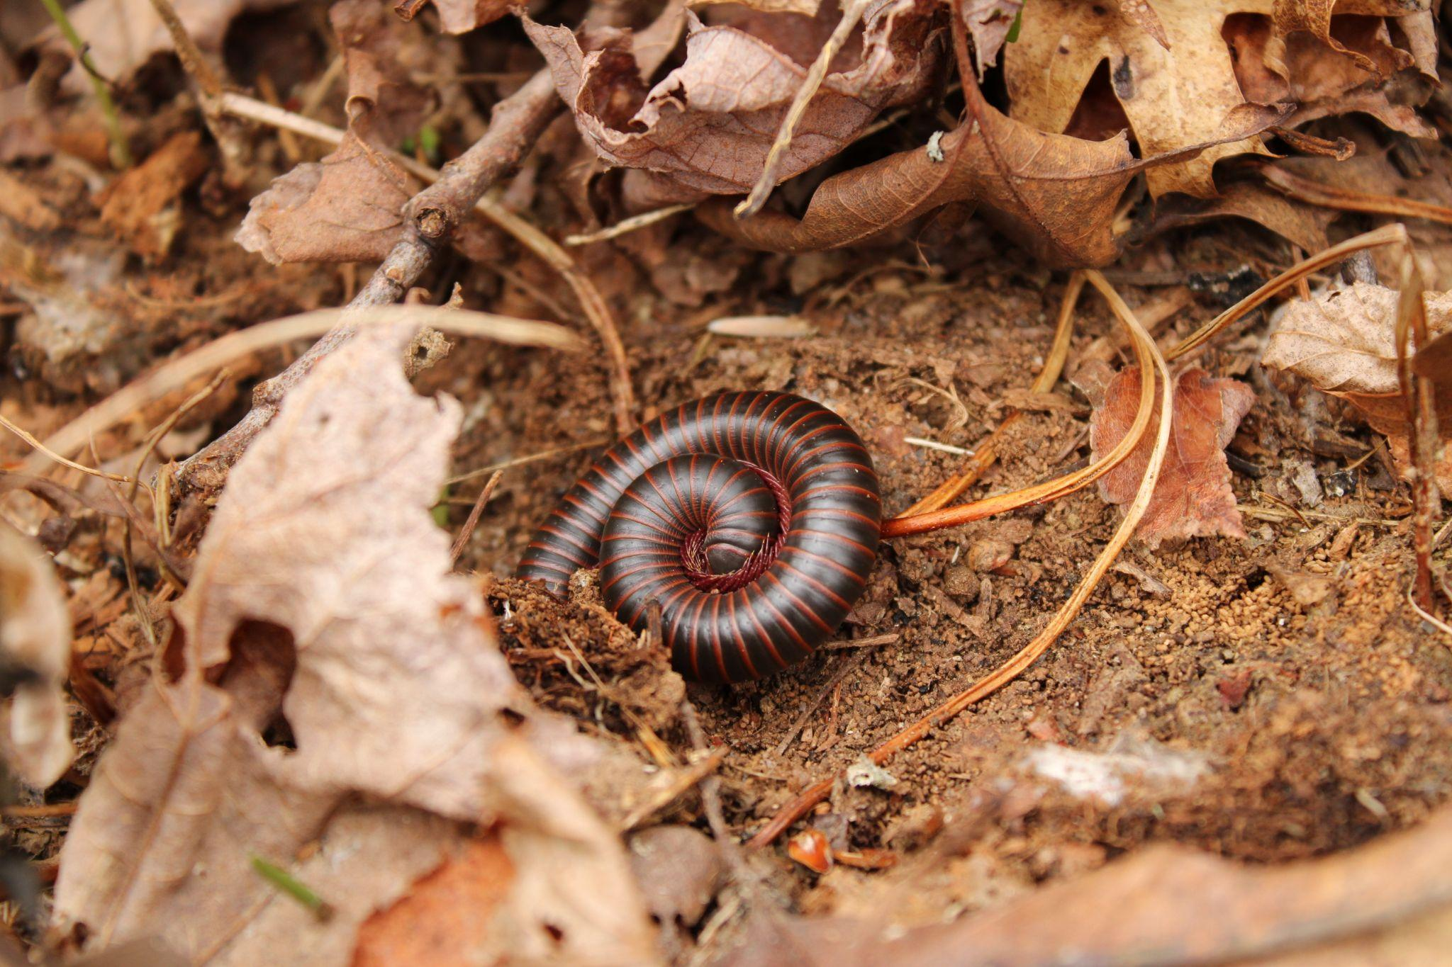
The North Woods Project
~300-acre parcel of forests and wetlands part of the University of Rhode Island’s campus.
Deep mapping
Creating a natural classroom
  Ecology
  History
  Art
  Social sciences
Using augmented reality (AR) technology to create new immersive experiences
Millipede photographed during the North Woods BioBlitz: Joe Ahart
Notes:
The North Woods Project is a multifaceted mission to create a strong community surrounding URI’s expansive natural area. Through various technologies, we are creating augmented experiences in order to discover new ways to engage with nature. One of our primary focuses is to create a ‘deep map’, which explores further than just geography. Ecology, history, and art can be included within a deep map layout, ultimately leading to a rich experience for everyone.
-Clarify acronyms
-Add summary

Slide 3
The North Woods Project
Goals
  Create digital content (photo/video, audio) for the North Woods Project (NWP)
  Learn and implement AR tools in the field
  Support student/faculty submissions
  Develop an understanding of deep mapping
  Strengthen current community and provide a foundation for growth
Notes:
Working with Madison Jones, Travess Smalley and other talented professionals, I am excited to be developing content for the North Woods project through a variety of mediums. Augmented reality, or AR, is one of the primary focuses on our project. We will be generating content such as trail signs, infographics, and interactive experiences that can be accessed through smart phones and other devices. This allows for endless expansion without disrupting the natural space. Students and faculty have been working on their own projects, and it is our job to ensure that these visions are able to come to life. From artists to conservationists, anyone who has a relationship with the North Woods is encouraged to share their ideas.

Slide 4
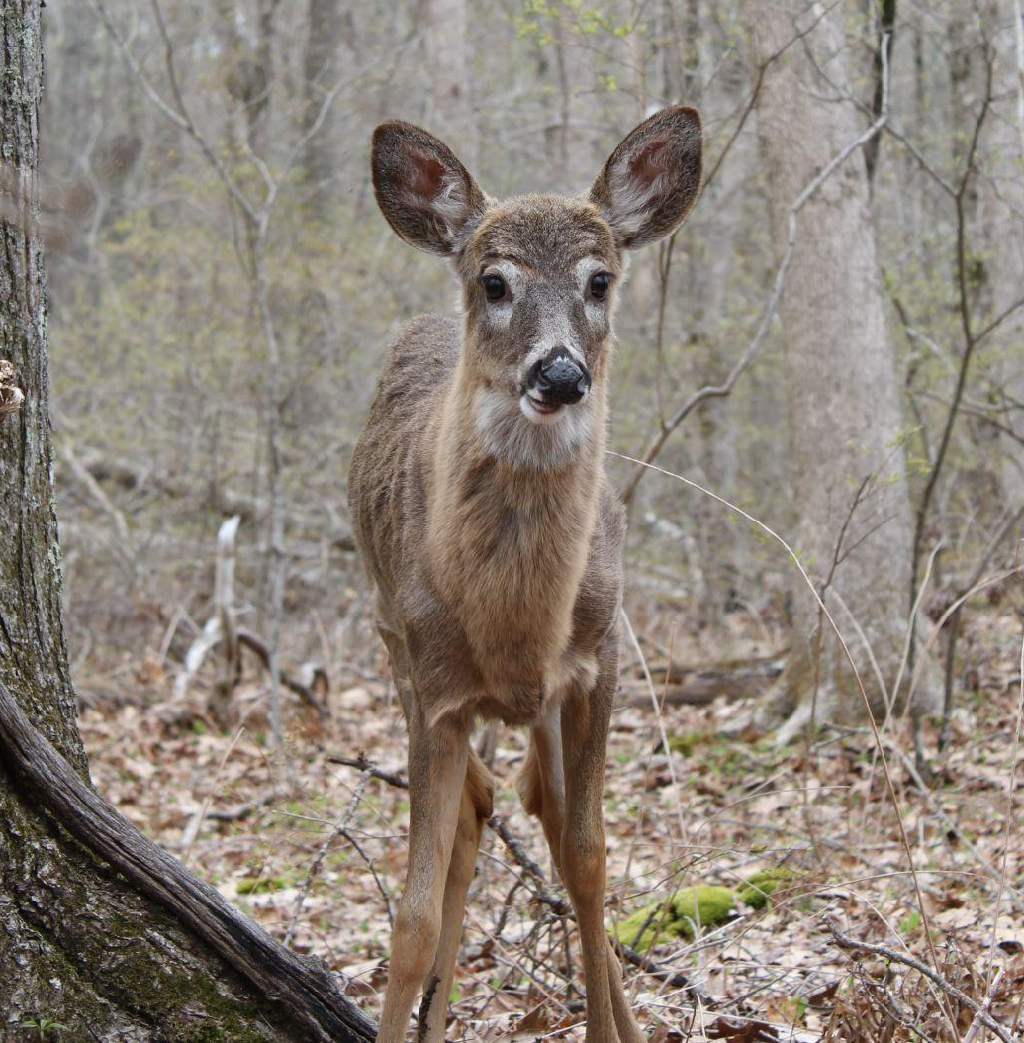
The North Woods Project
Timeframe: May 22nd, 2023 - August 4th, 2023
Juvenile white-tail deer in the North Woods: Joe Ahart
Notes:
Starting at the beginning of the summer, my time with the North Woods project will span until the end of the season. While this might be the end of the program, the North Woods project will certainly continue to grow.

Slide 5
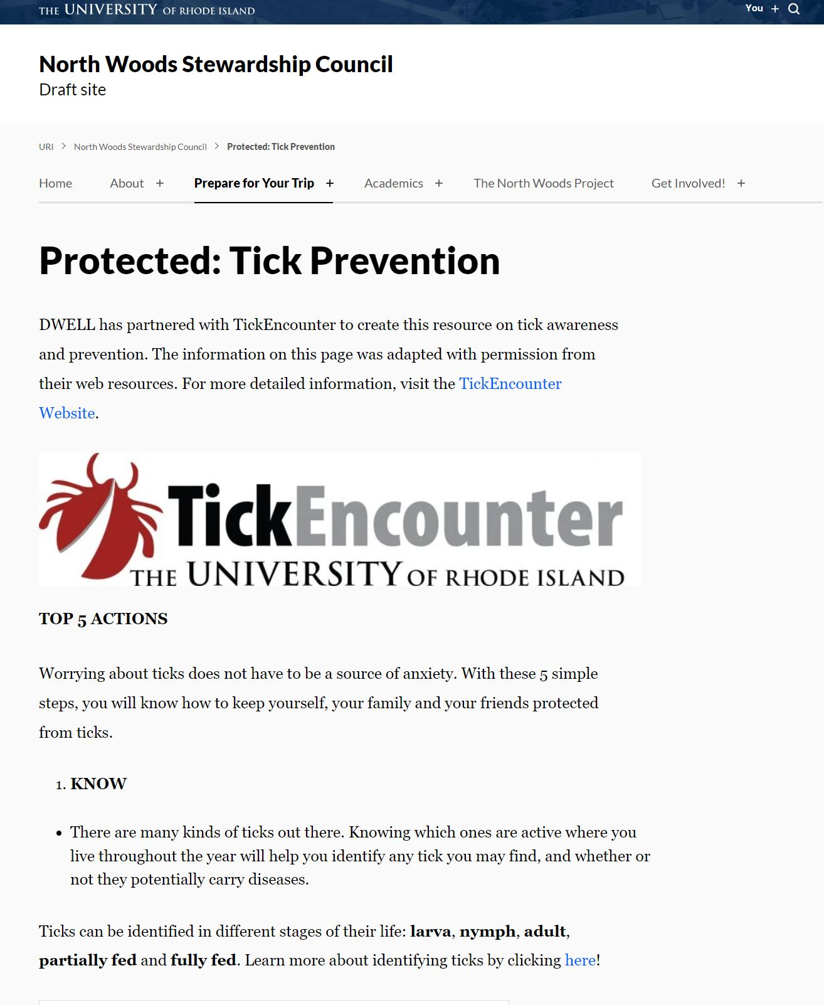
The North Woods Project
What we accomplished
  Captured photo, audio and video content
  Built foundations for the website, added several pages of content
  Promoted AR to other departments, started new potential projects

Slide 6
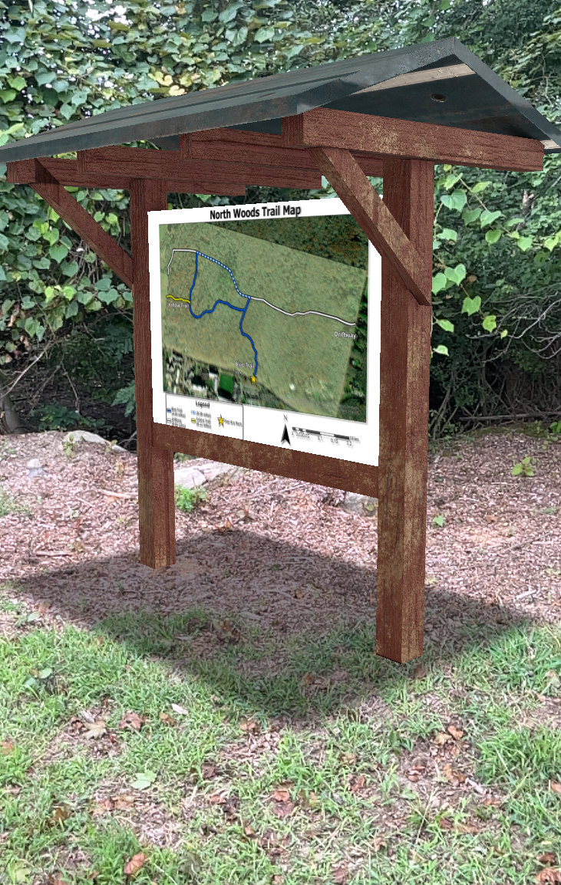
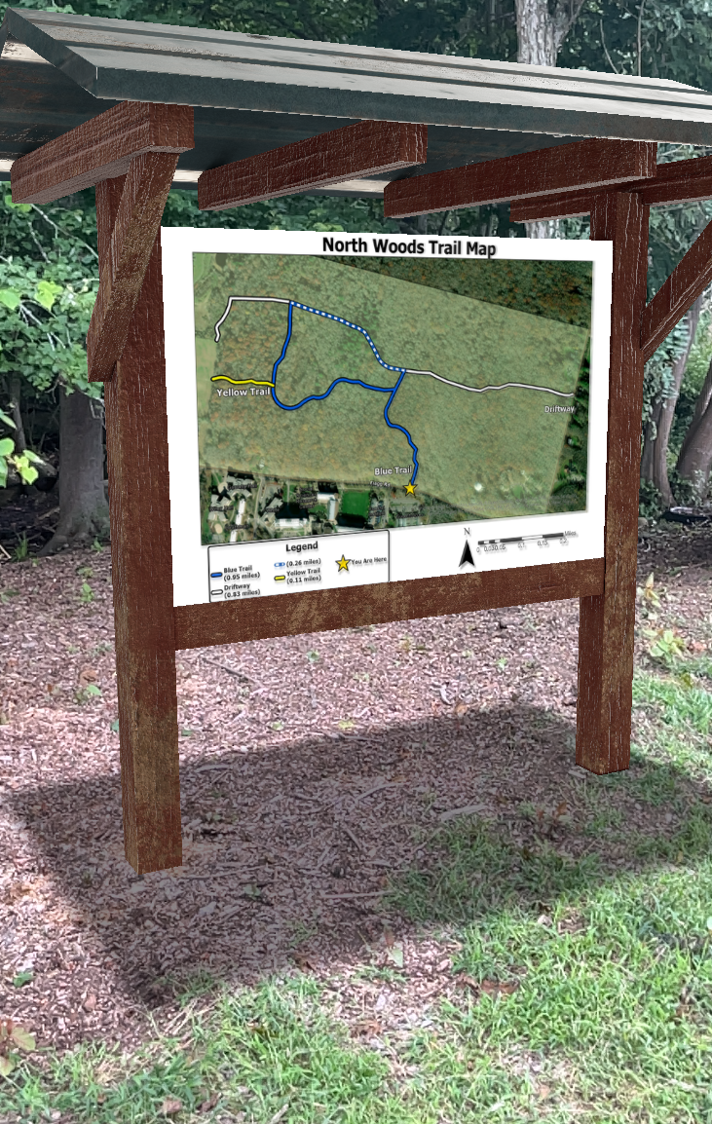
3D digital trailhead sign/Model: Madison Jones

Slide 7
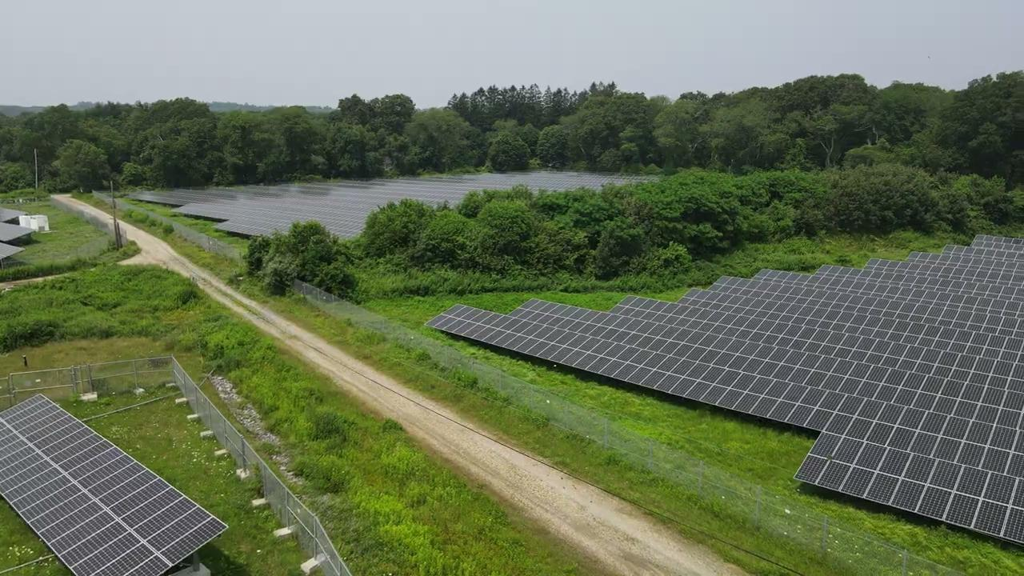
The North Woods Project
Drone footage captured by Madison Jones

Slide 8
Lessons Learned
What went well? What could we have done differently?
  Understanding ways to incorporate various types of digital content
  Learning necessary technical components
  It takes time for the process of integrating AR

Slide 9
Publications/Contributions
“Deep Mapping for Environmental Communication Design.” Madison Jones, Co-authored with Shannon Butts. Communication Design Quarterly, Online First, Spring 2021.

