Slide 1
Gravitational-wave Inference with Marginalization over Waveform Uncertainty
Student: Ritesh Bachhar, University of Rhode Island
riteshbachhar@uri.edu
Mentor/Researcher: Dr. Michael Pürrer, University of Rhode Island
mpuerrer@uri.edu
Date: June 14th, 2023
Notes:
Why do we need sampling algorithm to
What are the BBH parameters?

Slide 2
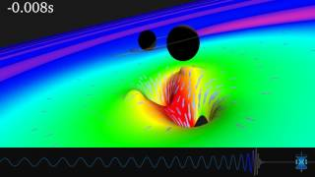
Gravitational Wave
Albert Einstein 1916
Ripples in spacetime
Accelerating massive object
Black holes & Neutron Stars
Notes:
Read about Gravitational wave from different sources

Slide 3
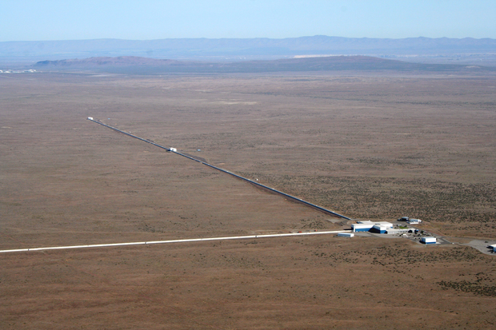
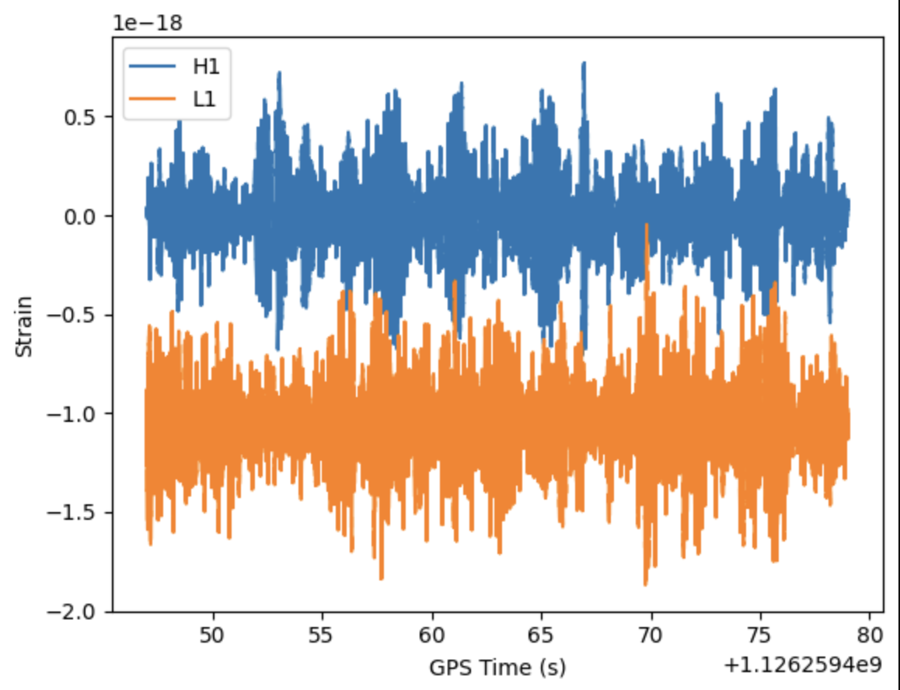
Gravitational Wave Observatory
Direct detection in 2015
Interferometric Observatory: LIGO-Virgo-KAGRA
LIGO:Hanford
Upcoming Observatory: ET; LISA Cosmic Explorer
https://www.ligo.caltech.edu/image/ligo20150731f

Slide 4
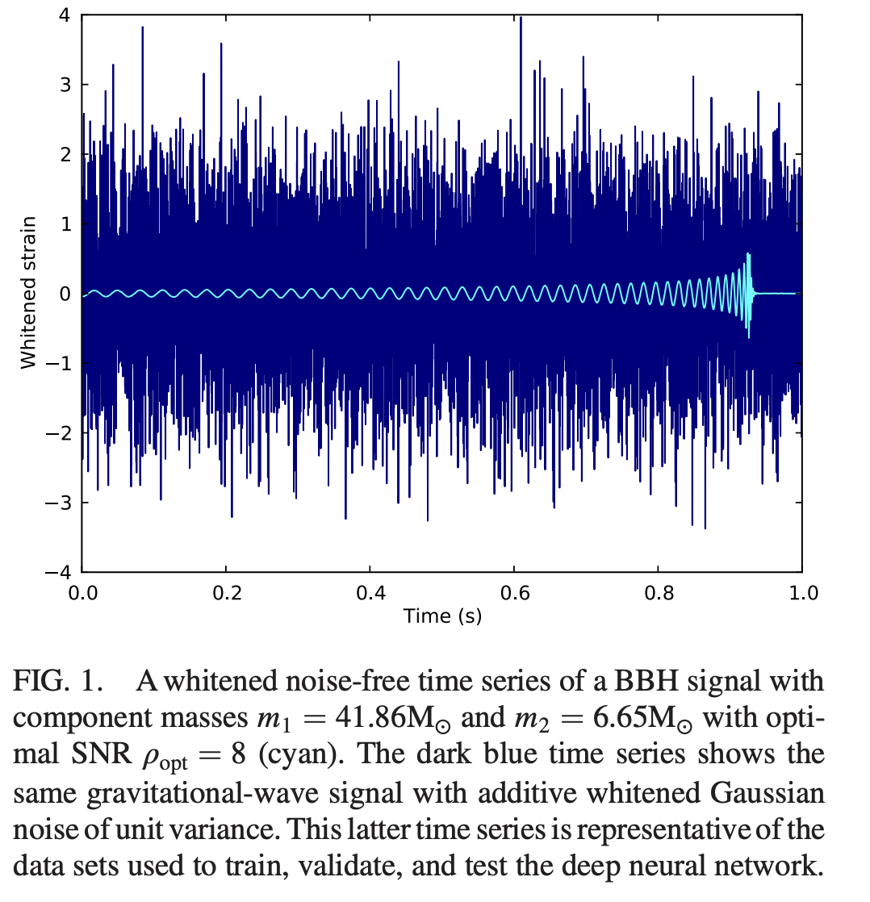
Waveform Models
Accurate waveform needed
  Detection and Parameter estimation
  Binary BH parameters: Mass, Spins, sky location etc
Numerical Relativity waveforms
Approximated waveforms
Uncertainty in wfs causes error in estimating BBH parameters
PhysRevLett.120.141103

Slide 5
Marginalizing of WF Uncertainty
Goals
  Marginalizing over wf Uncertainty
    Accurate PE
  Two different approaches:
    Bilby: Bayesian inference code for GW data analysis
    Dingo: Neural network based posterior estimation
  Compare Peak location of posterior with the true parameter
  Approximated waveform model: EOB GPR
Notes:
Add figure from Moore’s paper which shows the marginalization over parameter but using a different approach

Slide 6
Marginalizing of WF Uncertainty
Timeframe
  June 1st, 2023
  August 31st, 2023

Slide 7
Marginalizing of WF Uncertainty
What I hope to learn
  Parameter estimation of binary black holes
  Setting up PE workflow in Unity
  Parallel computing in CPU
  GPU: NVIDIA A100
  Slurm submission script
Notes:
Picture of Bilby and Dingo; what does they do?

Slide 8
Marginalizing of WF Uncertainty
Goals for Next Month
  Learn tools for estimating posterior distribution of binary parameter
  Generate training set for Dingo
~ 5 millions waveforms
  Get some preliminary comparison plots

Slide 9
Thank you!

